Slide 1
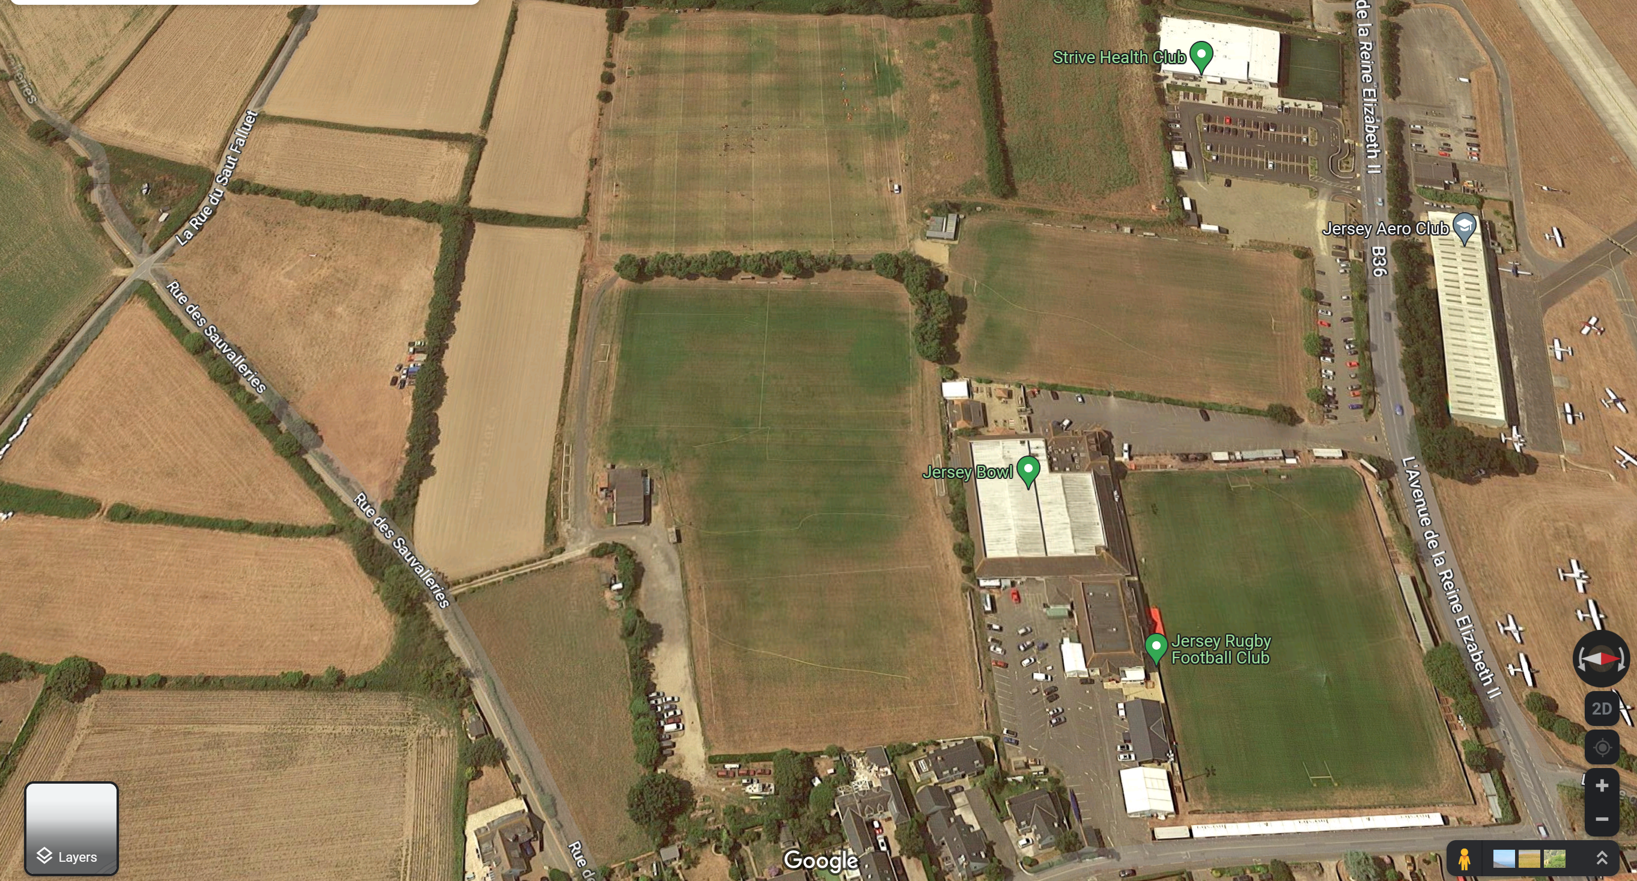





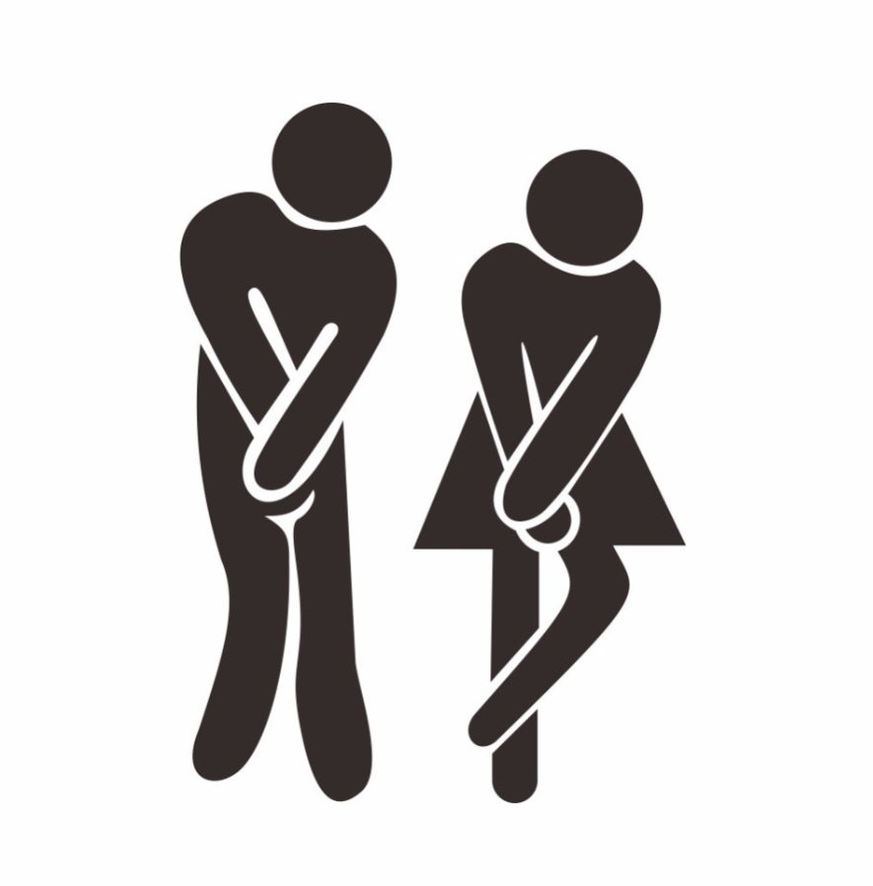

SIAM FESTIVAL MAP
PITCH 5
PITCH 4
PITCH 6
PITCH 2
PITCH 1
STRIVE
(GRAVEL AREA ONLY)
AERO CLUB
JRFC (Disabled only)
Pitch 6
*NOT JERSEY BOWL
PLEASE RESPECT MARSHALLS
BELLES BITES – PITCH 2/4
CLUB HOUSE (from 11am)
Also
JERSEY BOWL
STRIVE

